Slide 1

Machine Learning for Big Data
Dayoung Kang, Jaehyeon Kim, Subin Seo

Slide 2
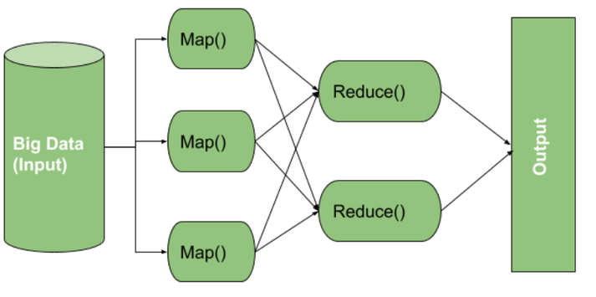
Review
Map Reduce
Automatic parallelization and distribution
Fault-tolerance
I/O scheduling
Status and monitoring
Spark
: provides a simple, efficient, and powerful programming model for a wide range of data.
Spark is an in-memory-based processing with faster operations than MapReduce.

Slide 3
Table of Contents
1
2
Local
PySpark
VS
★ Main points : to compare how fast and efficient data processing is performed
when using Spark and when not using it.
Reference
Data Reference : https://www.kaggle.com/datasets/subhamjain/loan-prediction-based-on-customer-behavior?resource=download&select=Sample+Prediction+Dataset.csv

Slide 4
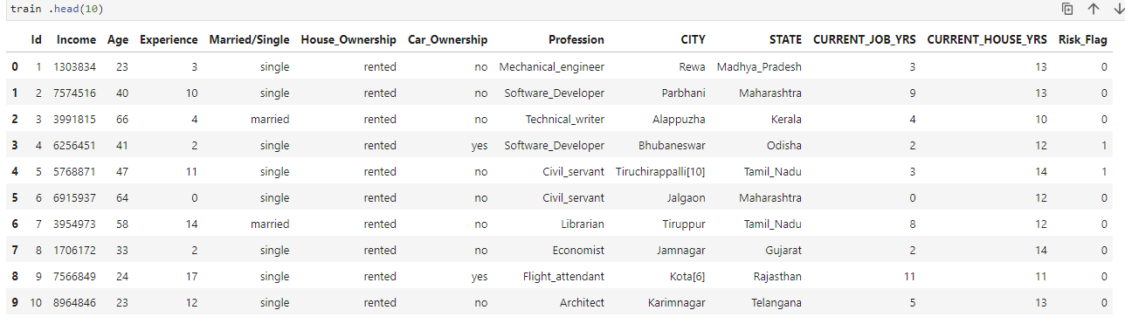
About Data
: To Predict who possible Defaulters are
for Loans Product Based on Customer information
Independent variables ( X )
Dependent variables ( Y )

Slide 5
About Data
Train_Data_shape : (252000, 13 )
It has Risk252,000 samples for learning the model.
There are 11 features dependent on _Flag(Y).
Risk_Flag(Y) is binary clas ( 0 or 1 ) .

Slide 6
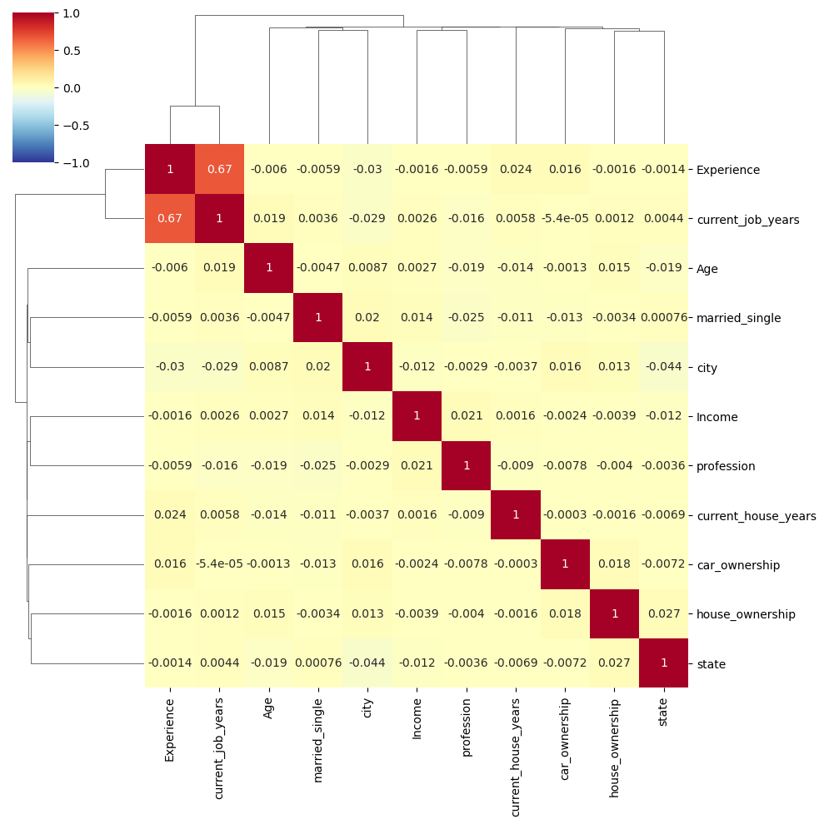
Data Representation
Independent variables
Experience is correlate with current job years.

Slide 7
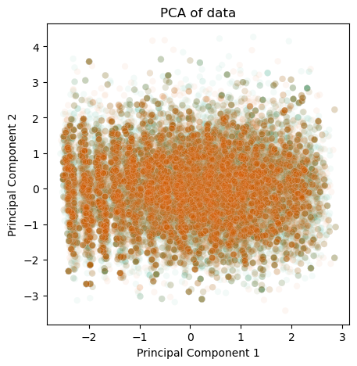
Data Representation

Slide 8
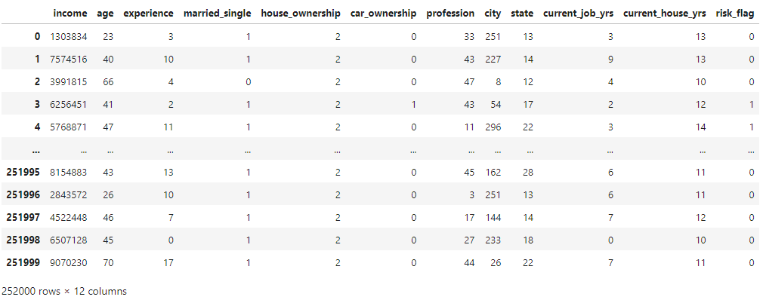
Pre-Processing
1
2
3
Label Encoding
Down sampling
Standard Scaling

Slide 9
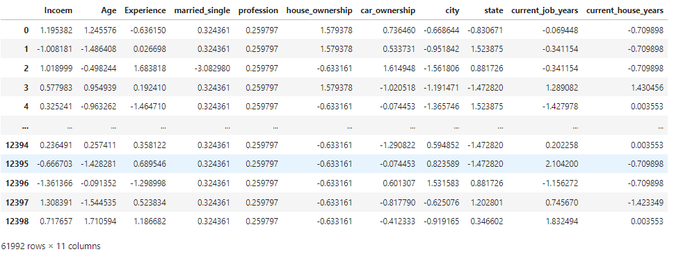
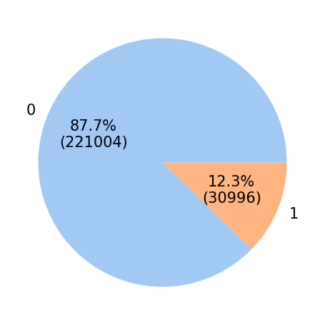
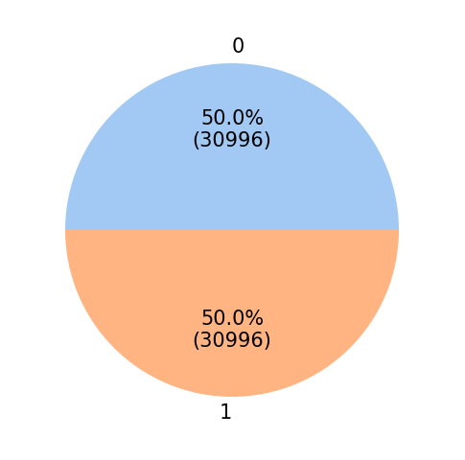
Pre-Processing
1
2
3
Label Encoding
Down sampling
Standard Scaling

Slide 10
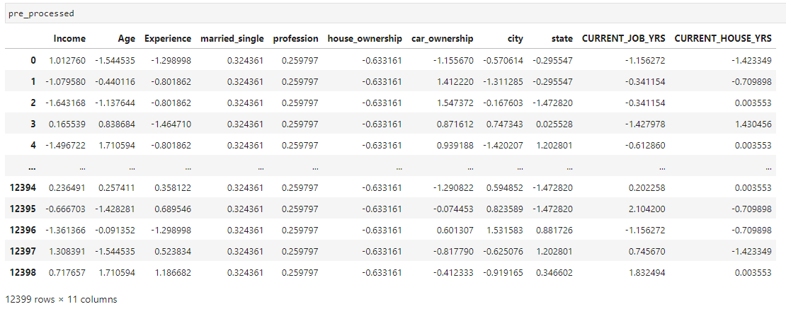
Pre-Processing
1
2
3
Label Encoding
Down sampling
Standard Scaling

Slide 11

Machine learning
Basic Introduction about SVM classification
SVM
Can be used to predict both of categorical and continuous data.
Overfitting can be reduced because there is a margin along with the decision boundary.
Try to find out hyperplane with largemargin.
https://www.analyticsvidhya.com/blog/2021/10/support-vector-machinessvm-a-complete-guide-for-beginners/

Slide 12
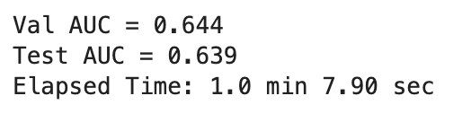
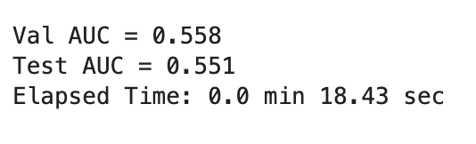
Compare performance
scikit-learn SVM | Pyspark SVM
AUC = 0.649 | AUC = 0.551
Elapsed Time: 1.0 min 7.90 sec | Elapsed Time: 0.0 min 18.43 sec
iteration=100,000
AUC = Number of correct predictions / Total number of predictions
Both AUC are seemed to be low, furthermore SVM with Pyspark’s score is similar to random prediction probability. ( Even if our project is focusing on the efficiency of model processing, It might be a problem. ..? )
The processing speed was definitely fast for about a minute with using Pyspark

